Slide 1





Chaos Synchronization via
Predictive Schemes
Giovanni Licitra
07/08/2015 Freiburg
‹#›

Slide 2
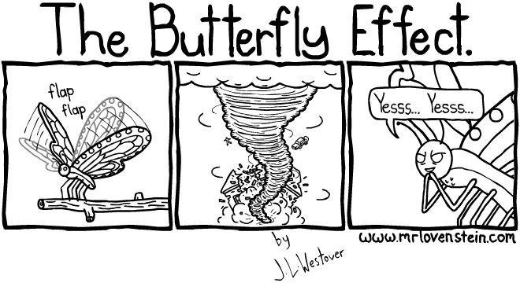
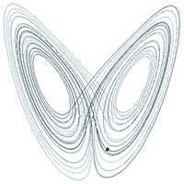

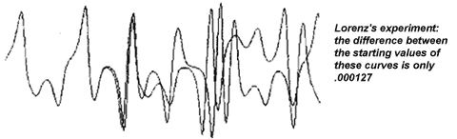
Does the Flap of a Butterfly’s Wings in Brazil set off a Tornado in Texas?
Chaos theory studies the behavior of dynamical systems that are highly sensitive to initial conditions and to the parameters of the system. A response popularly referred to as the butterfly effect.
‹#›

Slide 3
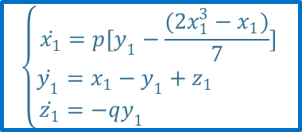
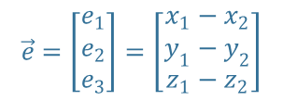
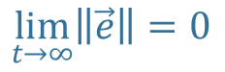
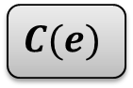
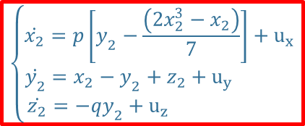
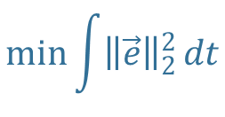
How to synchronize two chaotic systems
Master system
Synchronization condition
Slave system

Slide 4
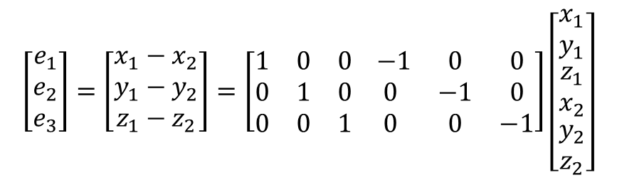
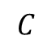
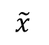
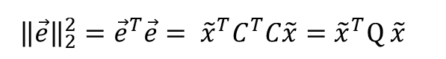
How to synchronize two chaotic systems (2)
This is nothing else that a regulation problem!!!
‹#›

Slide 5
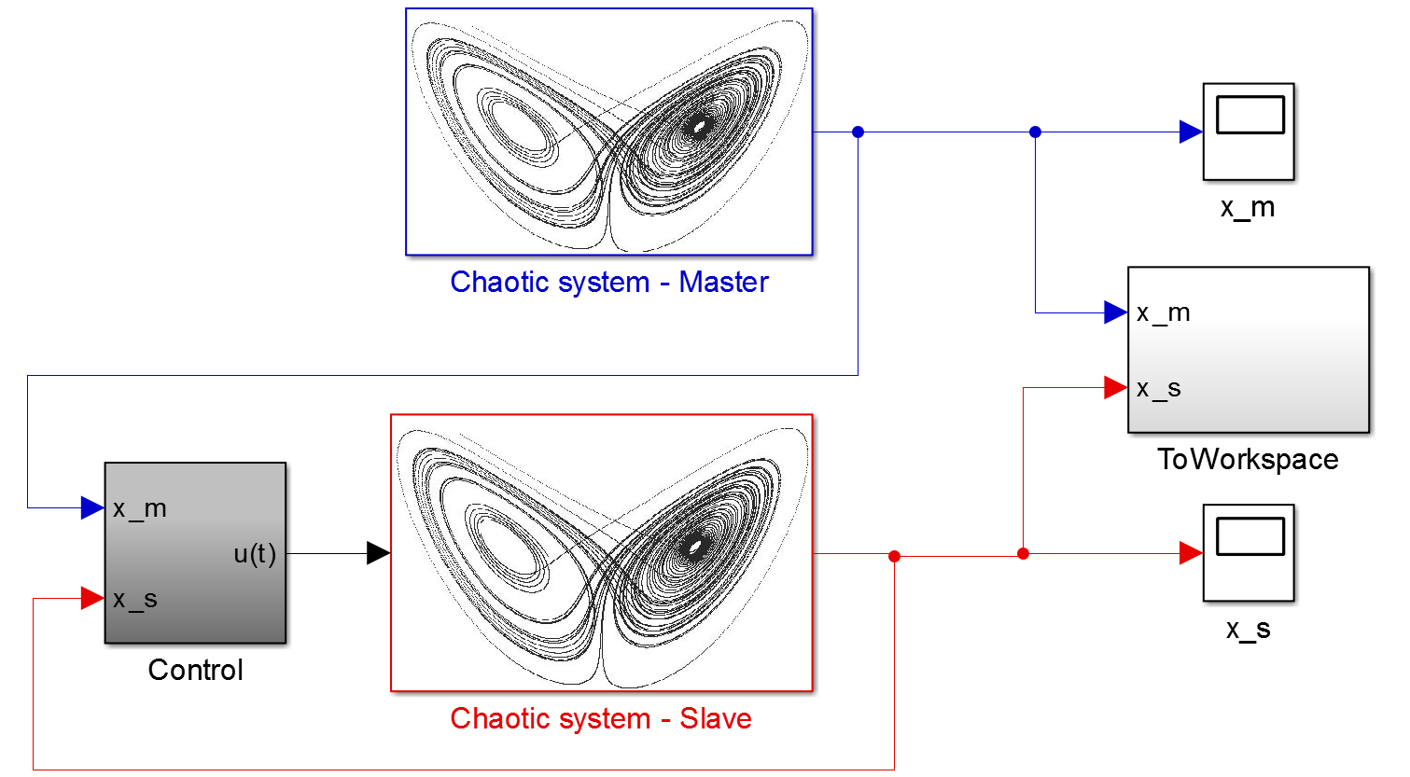
Simulink
scheme
‹#›

Slide 6
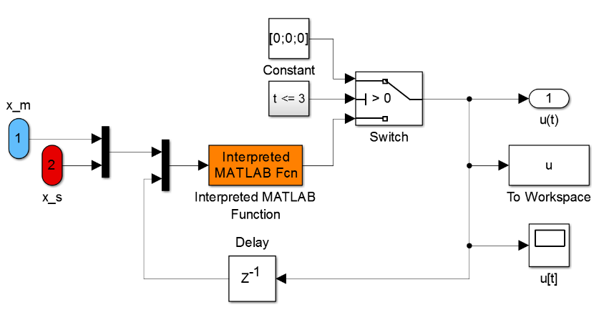
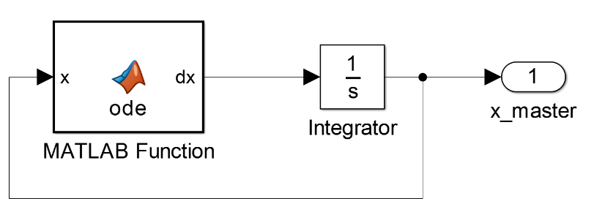

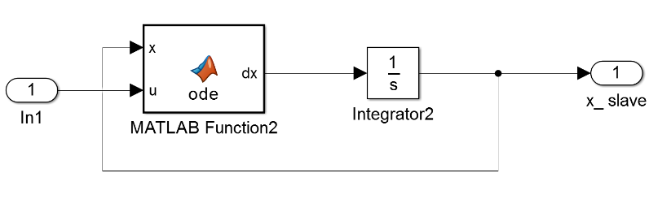
‹#›

Slide 7
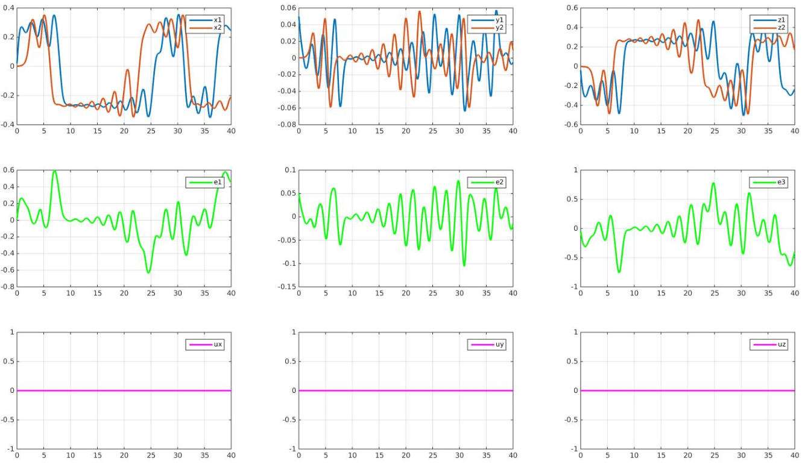
‹#›

Slide 8
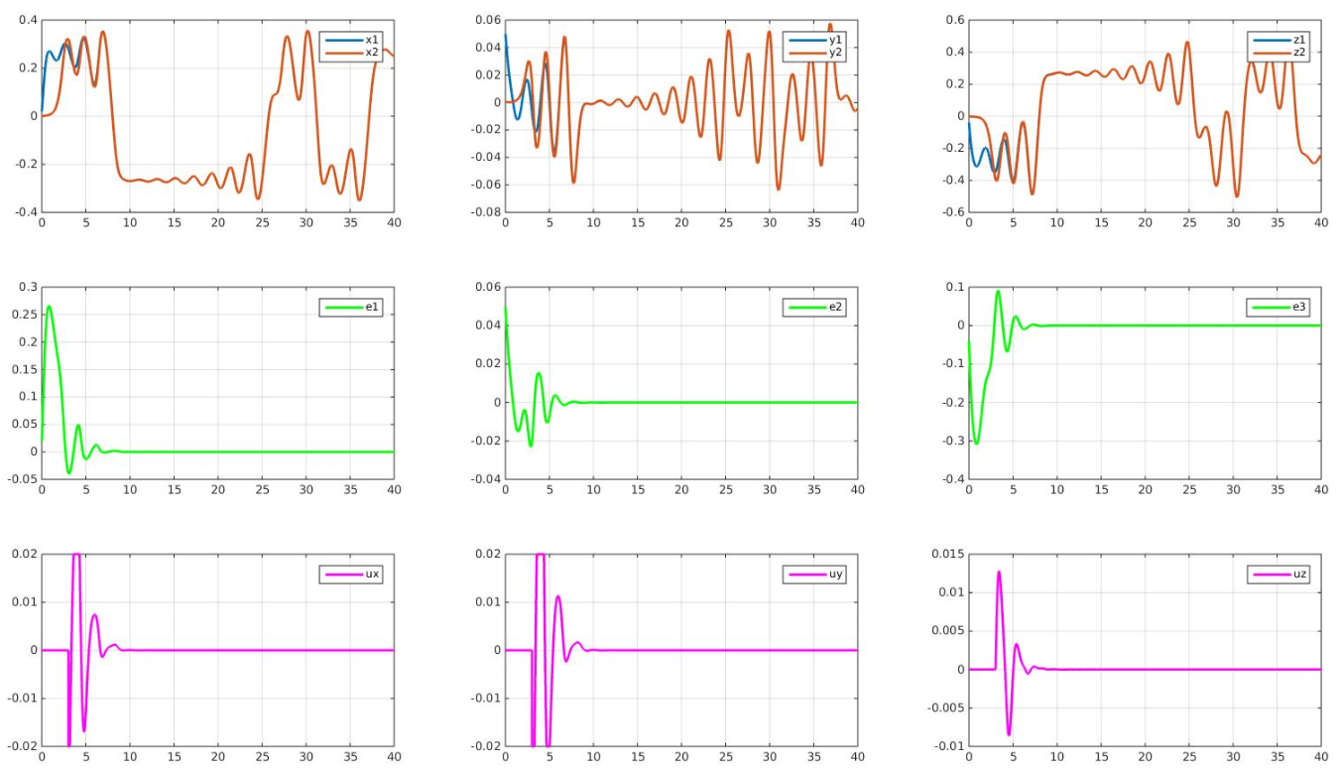
Synchronization via MPC (MPT toolbox)
Control stabilizes starting from t = 3 s
‹#›

Slide 9
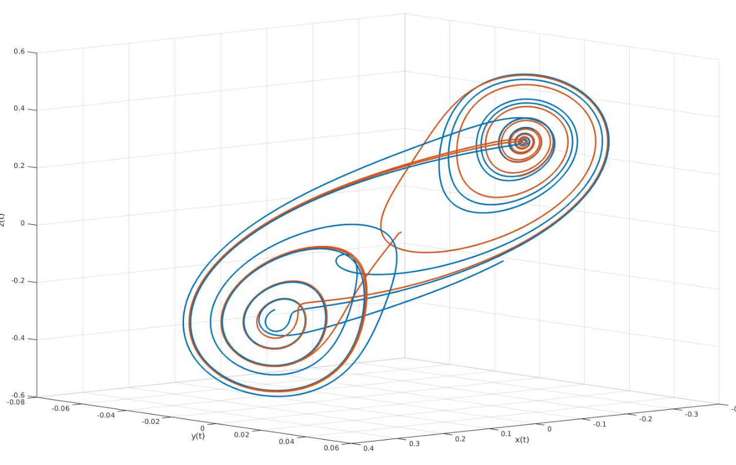
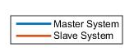
3D plot
‹#›

Slide 10
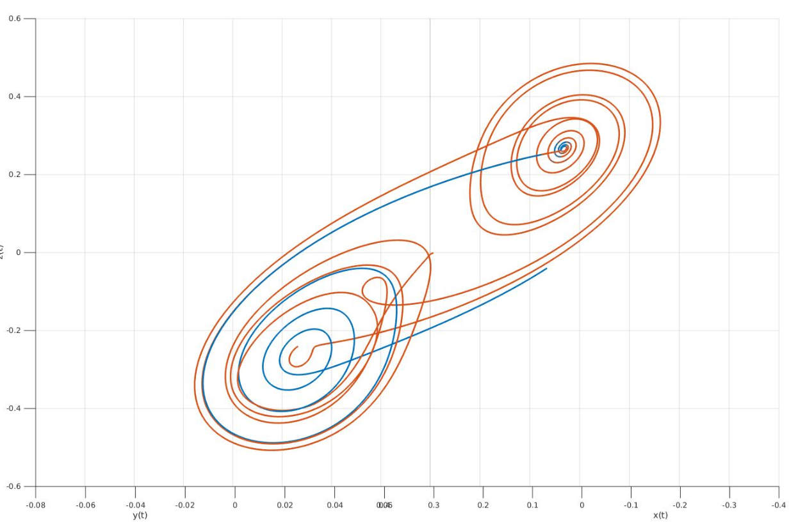
3D plot
‹#›

Slide 11
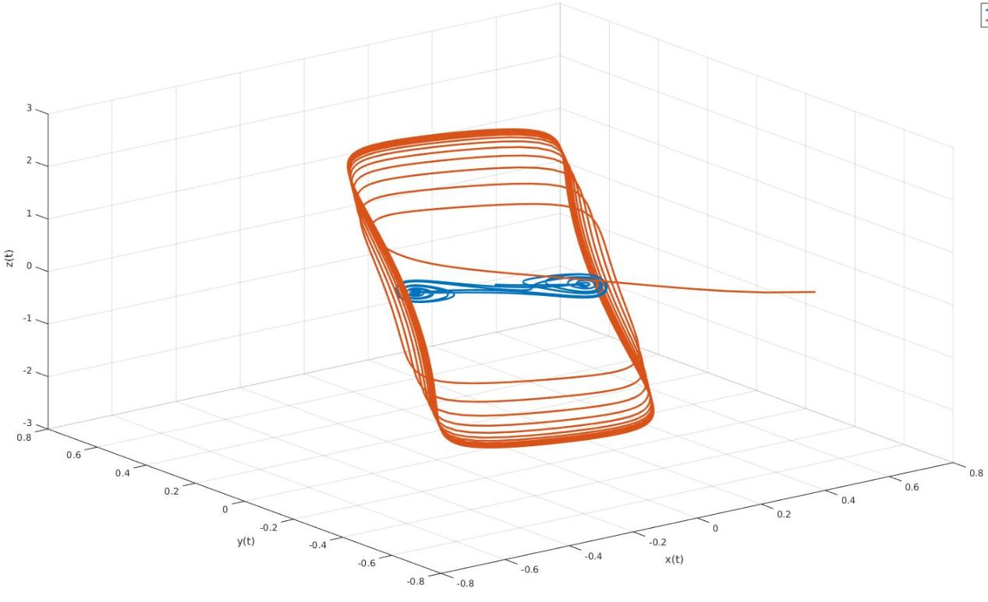
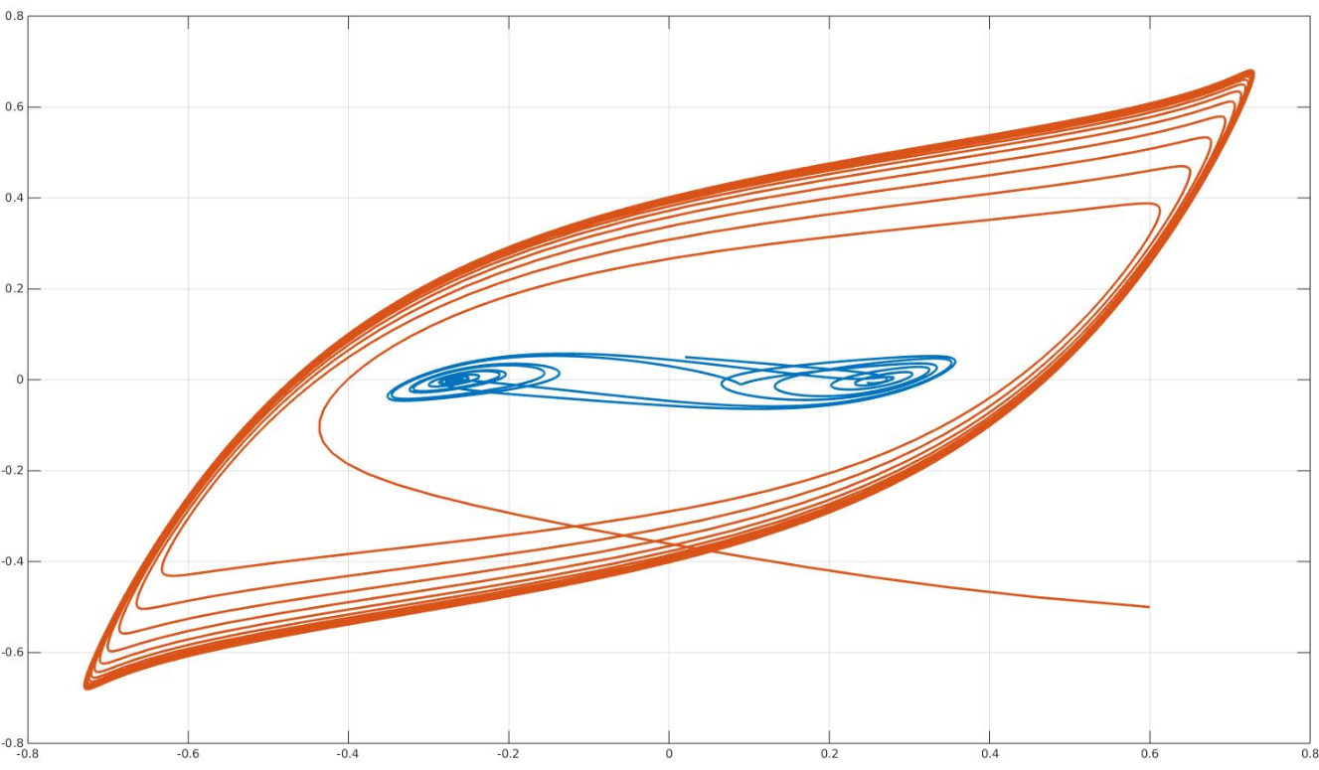
3D plot
2D plot
‹#›

Slide 12
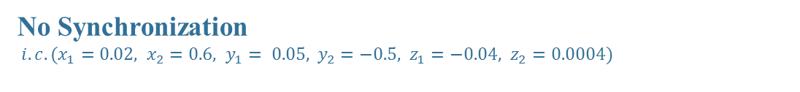
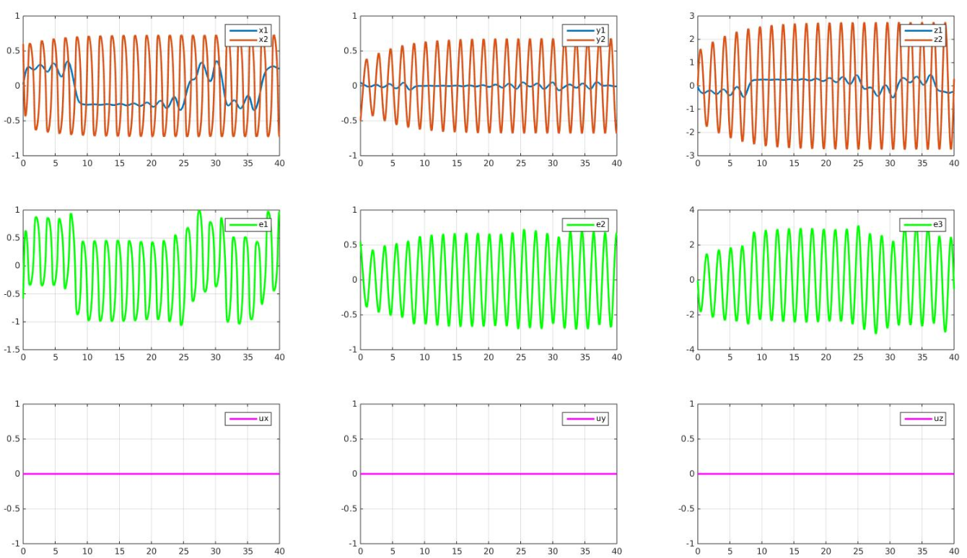
‹#›

Slide 13
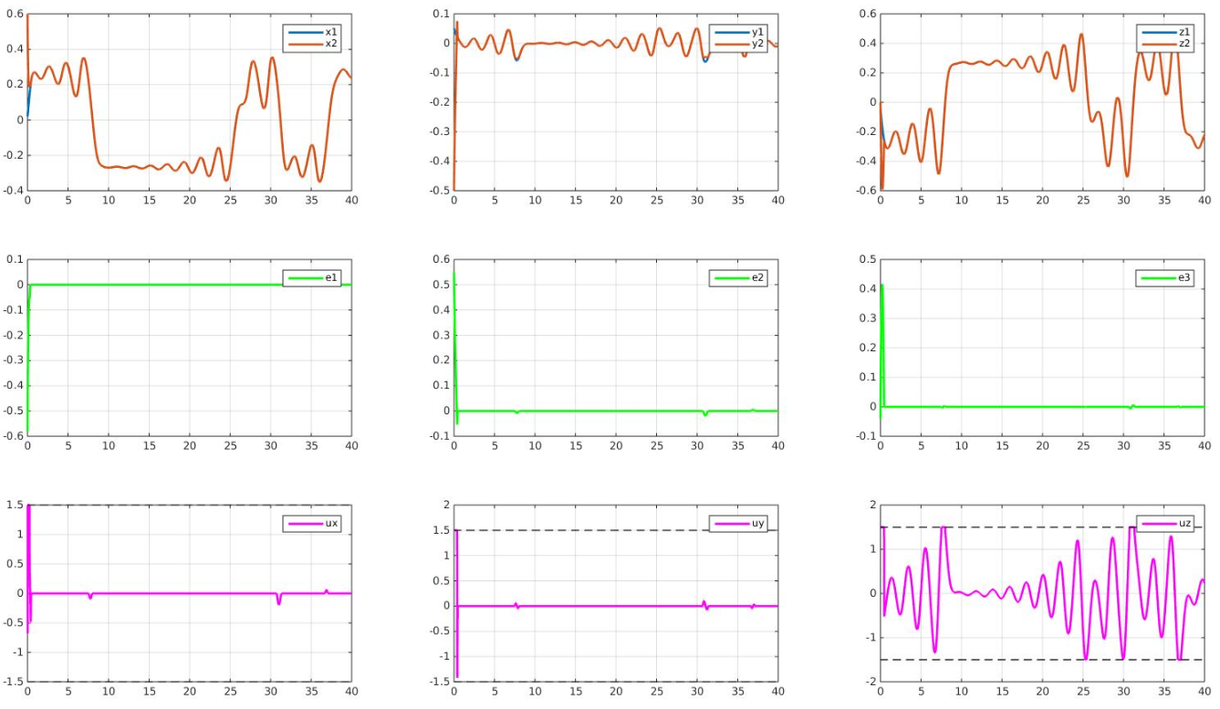
Synchronization via NMPC (ACADO Toolkit)
‹#›

Slide 14

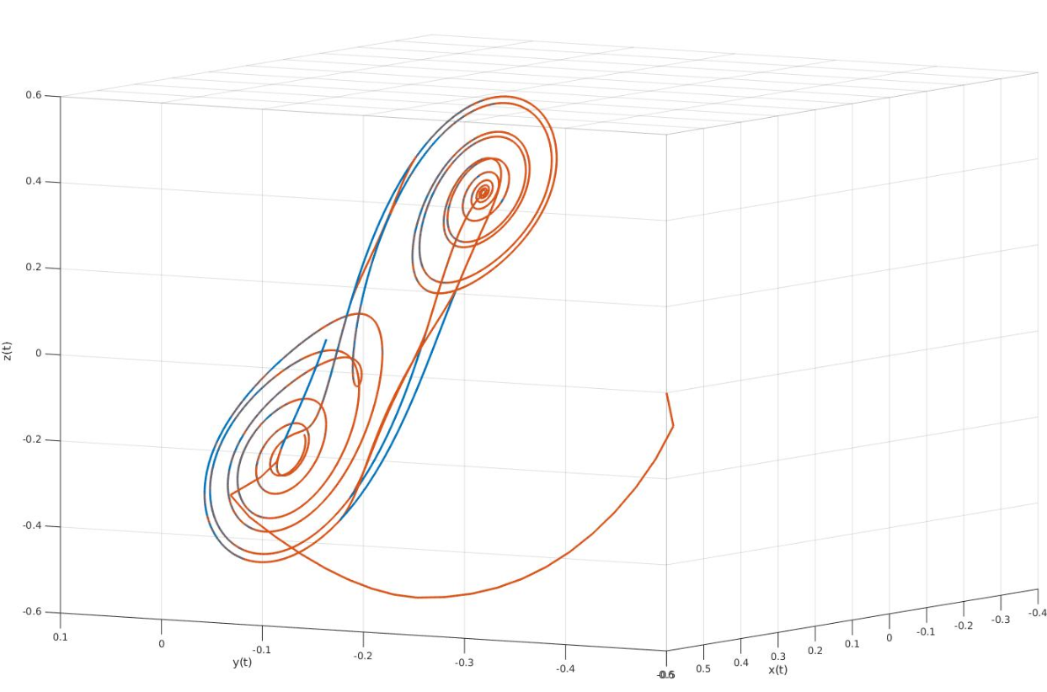
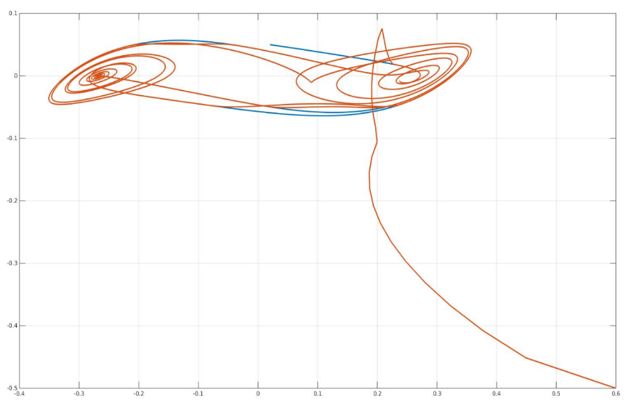
3D plot
2D plot
‹#›

Slide 15
If it is possible to synchronize chaotic systems, it should be simpler to synchronize deterministic ones...
‹#›

Slide 16
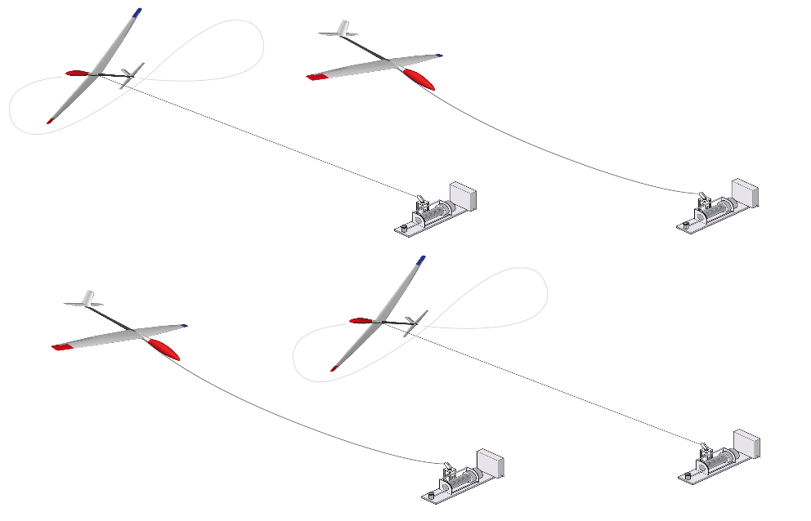
What's Ampyx Power?
Ampyx Power is a start-up company developing a novel wind energy technology. Its product, the PowerPlane®, a tethered high-strength autonomously controlled glider. The basic principle of power generation uses a “pumping cycle” that uses strong tether tension during roll-out to drive a generator at the ground
‹#›

Slide 17
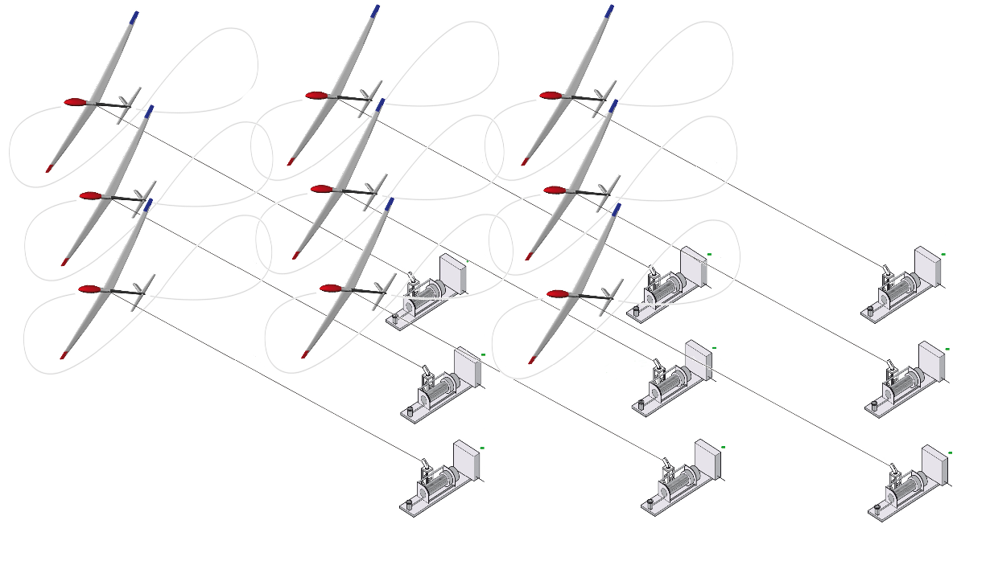
Why this concept could be useful
for Ampyx Power?
Given a fixed amount of land, it would be possible minimize the distance between these system in order to increase the number of them.
Moreover applying predictive schemes, geometric constraints could be enforced in order to avoid any crash.
‹#›

Slide 18

Thanks for your attention
‹#›

